Slide 1




HackOrbit 2025
Team Run Time Terror

Slide 2

THEME & PROBLEM STATEMENT
Theme: Open Innovation
Many innovative ideas fail to reach their potential due to lack of collaboration, mentorship, and access to resources. Inventors, researchers, and entrepreneurs often work in silos, missing opportunities to connect with experts, investors, and complementary projects. There is no centralized platform that effectively crowdsources ideas, matches them with relevant stakeholders, and supports their development through collaboration and resource sharing.

Slide 3
PROPOSED SOLUTION
Develop a web-based platform that crowdsources innovative ideas from individuals and organizations worldwide.
Use AI-powered algorithms to analyze submitted ideas and match them with mentors, collaborators, and funding opportunities.
Provide collaborative workspaces where teams can develop ideas, share feedback, and track progress.
Enable community voting and feedback to prioritize promising ideas.
Offer analytics dashboards to monitor innovation trends and project milestones.
Facilitate partnerships between academia, industry, and investors to accelerate idea commercialization.

Slide 4
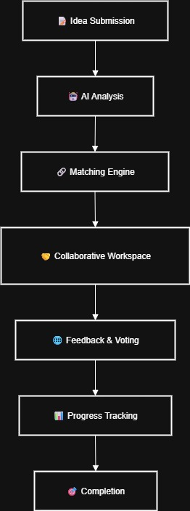
FLOWCHART / DIAGRAM

Slide 5
FLOWCHART / DIAGRAM
Idea Submission (Users submit ideas on the platform)
AI Analysis & Categorization (NLP and clustering algorithms analyze ideas)
Matching Engine (Matches ideas with mentors, collaborators, and investors)
Collaborative Workspace (Teams form and work on ideas)
Community Feedback & Voting (Crowd evaluates and prioritizes ideas)
Progress Tracking & Resource Allocation (Dashboard for monitoring and support)

Slide 6
FEATURES AND NOVELTY
AI-Powered Matching: Intelligent pairing of ideas with relevant experts and resources.
Collaborative Workspaces: Integrated tools for communication, document sharing, and project management.
Crowdsourced Validation: Community-driven idea evaluation to surface the most promising innovations.
Open Access: Inclusive platform encouraging cross-sector collaboration (academia, startups, corporates).
Innovation Analytics: Real-time insights into emerging trends and innovation hotspots.
Resource Marketplace: Connects users with funding, prototyping facilities, and legal support.

Slide 7
DRAWBACK AND SHOWSTOPPERS
Ensuring quality and originality of submitted ideas to avoid plagiarism.
Data privacy and intellectual property protection concerns.
User engagement and sustained participation challenges.
Potential biases in AI matching algorithms.
Need for robust moderation and conflict resolution mechanisms.
Scaling the platform to handle large volumes of users and ideas.

Slide 8
TEAM RUN TIME TERROR
Tarun Kushwaha(0901EC231139), EC 3rd Year, MITS Gwalior
Contact: 8819806319 , 23ec10ta141@mitsgwl.ac.in
Vaidant Shrivastava(0901EC231148), EC 3rd Year, MITS Gwalior
Contact: 7089857663 , 23ec10va150@mitsgwl.ac.in

Slide 9
Thank you

